Slide 1
LẬP TRÌNH TRÊN THIẾT BỊ DI ĐỘNG
BUỔI 4 PHÁT TRIỂN ỨNG DỤNG DI ĐỘNG NATIVE iOS
GVGD: ThS. Huỳnh Tuấn Anh

Slide 2
Outline
Introduction
iOS History
iOS and Ecosystem
iOS Architecture
iOS Application Development
Hello World
Objective C, Swift

Slide 3



History
IOS or iPhone OS is a mobile operating system created and developed by Apple Inc.
Originally designed for the iPhone but now supports iPod touch,iPad and Apple Tv
Released on June 29, 2007
It is updated just like Itune for iPods
Written in C, C++, Objective-C, Swift, assembly language
First iOS logotype (2010–2013)
Second iOS logotype (2013–2017
Third iOS logotype (2017–present)

Slide 4
History
iOS 1: The birth of the iPhone (2007)
iOS 2: App Store (2008)
iOS 3: iPhone Enhancements (2009)
IOS 4: Multitasking, Retina and Facetime (2010)
IOS 5: Notification center, Siri & More (2011)
IOS 6: Apple Maps & Passbook (2012)
IOS 7: Wireless sharing feature Airdrop (2013)
IOS 8: iCloud Drive (2014)
iOS 9: 3D touch (2015)
iOS 10: Facial Recognition (2016)
iOS 11: Live Photos (2017)
iOS 12: Emoji (2018)
iOS 13: Dark Mode (2019)
iOS 14: Widgets, App Library (2020)

Slide 5
History
Among the technological tribe, the most popular terms associated with mobile phones are Android and iOS. While the former allows transparency and easy accessibility, the latter has carved a mass for itself, even though it allows strict connectivity. But when it comes to iPhones, the loyal customers forget all of its cones and just stick on to the beauty, elegance and the magical iOS that runs like a pure charm.
It was on June 29, 2007, Steve Jobs, the then chairman and co-founder of
Apple.Inc launched iPhone with iOS 1. Since then, the operating system has undergone some major upgrades, which was a result of continuous hard work and passion towards achieving beyond the expectations of the consumer. Here, we are glad to give you a brief sneak peek into the history of world’s favourite operating system.
Notes:
Trong bộ tộc công nghệ, các thuật ngữ phổ biến nhất liên quan đến điện thoại di động là Android và iOS. Trong khi cái trước cho phép tính minh bạch và khả năng truy cập dễ dàng, cái sau đã tạo ra một khối lượng lớn cho chính nó, mặc dù nó cho phép kết nối chặt chẽ. Nhưng khi nói đến iPhone, những khách hàng trung thành lại quên đi tất cả những gì thuộc về nó và chỉ chăm chăm vào vẻ đẹp, sự sang trọng và hệ điều hành iOS ma thuật chạy như một sự quyến rũ thuần túy. Đó là vào ngày 29 tháng 6 năm 2007, Steve Jobs, lúc đó là chủ tịch và đồng sáng lập của Apple.Inc đã ra mắt iPhone với iOS 1. Kể từ đó, hệ điều hành này đã trải qua một số nâng cấp lớn, đó là kết quả của quá trình làm việc chăm chỉ liên tục và niềm đam mê hướng tới việc đạt được những gì ngoài mong đợi của người tiêu dùng. Tại đây, chúng tôi vui mừng cung cấp cho bạn một cái nhìn sơ lược về lịch sử của hệ điều hành được yêu thích trên thế giới.

Slide 6
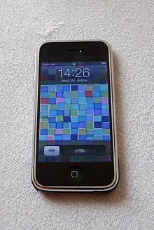
i O S 1( i Phone O S 1)
The brainchild of Steve Jobs introduced the idea that an iPod, camera, phone and internet device could be compacted inside a device that fits in your pocket. At that time, iPhone was the actual star and other than the technological geeks, no one was really interested in any information about the operating system which made those phones work flawlessly.
iPhone OS 1, as it was named, was so special among the customers
as it was designed for multi-touch operation and a 3.5” capacitive touchscreen, which made it quick and responsive than any other present in the market then. While comparing it with the consecutive versions of iOS, this version lacked huge including support for native, third-party apps. But at the time of its launch, the phone and iOS 1 created a massive buzz among the elites and technologically inclined lot.

Slide 7
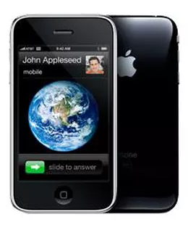
i O S 2 ( i Phone O S 2)
iPhone OS 2 released a year after, on July 2008 created a major breakthrough by adding App store, which allowed the support of native, third- party apps. More than 500 third-party apps were added on App store during its launch, along with built-in 3G and GPS technology. This gave smartphone market the capacity to think limitless, which was visible from Google’s move just after a month of iOS 2 launch- android released Android Market, an older version of Play Store.

Slide 8
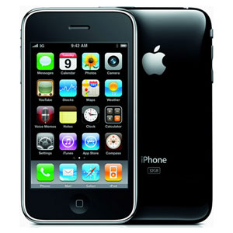
i O S 3 ( i Phone O S 3)
On June 2009, the next upgrade - iPhone OS 3- was not about any dramatic inventions or transformations, but they focused on fine-tuning the already developed programs. Jobs elevated the whole iPhone using to the next level by adding push notifications for third-party apps, parental controls, tap to focus in the camera, in-app purchases and subscription models, universal search with spotlight, and cut, copy, paste for the touchscreen age.
Next January, iPad was launched with an updated version of iOS 3 tailor-made
just for the new model. iTunes was also upgraded by adding options to buy movies, TV shows and books from iPhone or iPod touch.

Slide 9
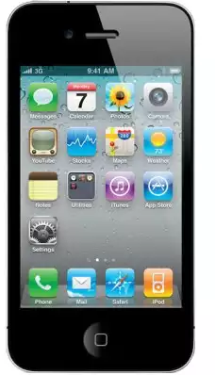
i O S 4 ( i Phone O S 4)
Multitasking was the word of Apple in June 2010, when they introduced iOS 4 enabling the user to switch between the apps in a flash with a double press on the home button. The feature loaded update had the name iOS given to it, leaving behind the word “phone” from the name of the operating system indicating its compatibility with iPhones, iPods and iPads. FaceTime, multitasking, iBooks, organizing apps into folders, Personal Hotspot, AirPlay and AirPrint, some of the current popular OS apps were introduced then.

Slide 10
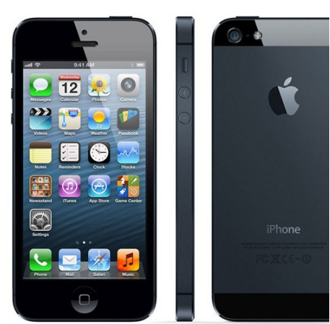
With the launch of iOS 5 in 2011, Apple was beginning an era of virtual assistants. Yes, Siri was added to iPhone in this version and the whole world went crazy behind this possibility of having a virtual assistant inside your phone, that will actually obey your tasks and even tell you jokes. Apple was also getting ready to create new wave enemies in future like Whatsapp, by introducing iMessage and iCloud.
i O S 5 ( i Phone O S 5)

Slide 11
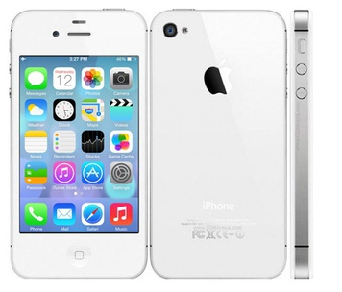
i O S 6 ( i Phone O S 6)
iOS 6, launched in 2012 witnessed a major fail- the introduction of Apple maps as a counter-attack on popular google maps.It is marked as a mediocre step from the stellar Apple.Inc, as it didn’t make any noise even among Apple’s most loyal customers or even inside Apple family. They also removed Youtube from the pre-installed set of apps. Some other added features include a tighter integration with Facebook, a new Passbook app and the iCloud allowing
shared photo streams.
Notes:
Iphone

Slide 12
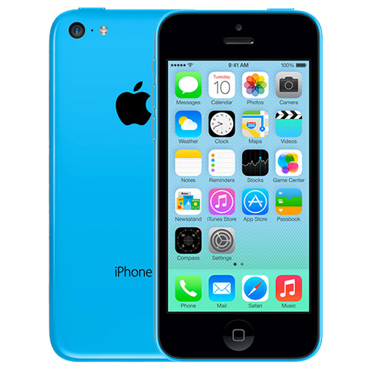
i O S 7 ( i Phone O S 7)
The world shouted “flat is beautiful” as the new iPhone was released with an updated iOS 7. The features included Contol Centre which meant quick settings, iTunes radio service, multitasking for all the apps, updated versions of Safari and Siri, and finally Airdrop was introduced which enabled easy connectivity and file transfer to other iPhones.
Notes:
5s, 5c

Slide 13
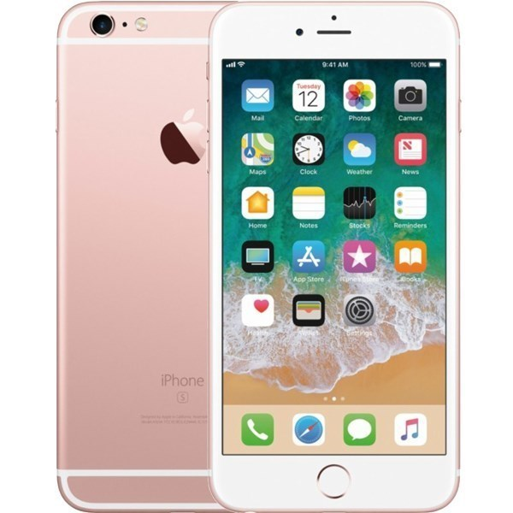
i O S 8 ( i Phone O S 8)
Again, in September 2014 Apple was in the mode of fine-tuning the existing features. Firstly, they brought together their desktops and mobile phones closer by providing a continuity concept enabling the user to send, edit and receive messages or answer phone calls on both phones and Mac. They opened up the platform wider by allowing third-party widgets and keyboards for users to customize their iPhone and introducing a successful and secured payment option- Apple pay. Also, iOS 8 engraved a new concept of addiction- a health tracking app named health kit.
Notes:
Iphone 6 plus

Slide 14
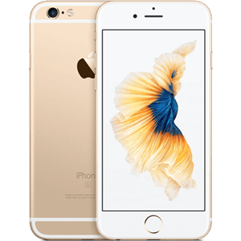
i O S 9 ( i Phone O S 9)
In September 2015, iOS 9 was unveiled.
Major transformation was that Siri got
way smarter- Apple named it Proactive
that is it brought back full panel spotlight feature with intelligence. This version of iOS felt like polishing every minute detail to catch up with its equivalents. Apps like notes, transit, Apple music and news got a major fix, and 3D touch was introduced.
Notes:
Iphone 6s

Slide 15
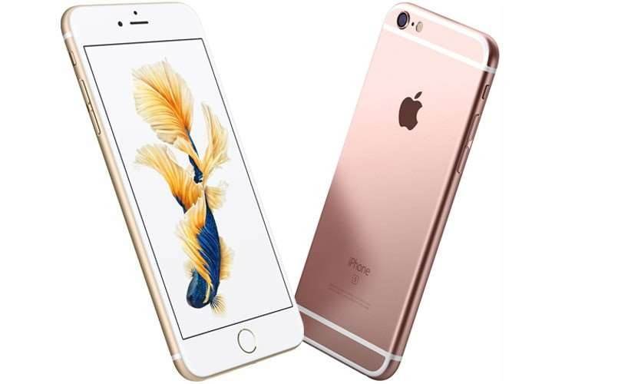
i O S 10 ( i Phone O S 10)
This time, the world witnessed a wide opening up of Apple products to third- party apps. Siri and iMessage were redesigned to allow strong third-party integration thus connecting with Uber, Pinterest and other popular names.
Apple also shared some love to their
users by filtering the photographs by location, facial recognition and other details, also automatically treasured their precious moments together into albums and video highlights.
Notes:
Iphone 7

Slide 16
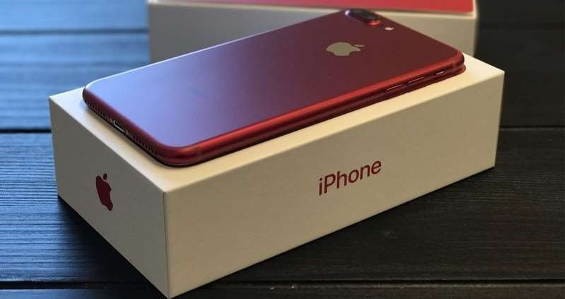
i O S 11( i Phone O S 11)
September 11, 2017, showed the world what is going to be the future of smartphones. Apple once again swept the hearts of its users by changing the look and feel of App store- a new design and regular editorial content helped users find apps more easily. All the other major improvements were targetted on iPad, the most important ones being new files app and dock, a novel concept for drag and drop interactions and simpler multitasking.
Notes:
Iphone 8

Slide 17
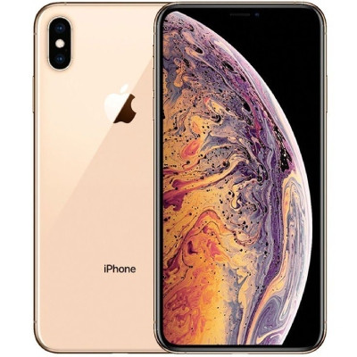
i O S 12 ( i Phone OS 12)
Apple announced iOS 12 on June 4, 2018, at its annual Apple Worldwide Developers Conference (WWDC) event, and it was released to the public on September 17, 2018, alongside the iPhone XS, iPhone XS Max and iPhone XR.
With this release, Apple did not drop support for any iOS devices. Therefore, iOS 12 was supported on the iPhone 5S onwards, iPod Touch (6th generation), the iPad Air onwards, and the iPad Mini 2 onwards. However, iOS 12 has limited support on devices with the Apple A7 or A8 processors: the iPhone 5S, iPhone 6/6 Plus, iPod Touch (6th generation), iPad Air, iPad Air 2, iPad Mini 2, 3, and 4.
All other devices from the iPhone 6S/6S Plus onwards, the iPad Air (2019), the iPad (5th generation) onwards, and all iPad Pro models are fully supported. iOS 12.1 bought support to the iPad Pro (12.9-inch, 3rd generation) and iPad Pro (11-inch, 1st generation) and iOS 12.2 bought support to the iPad Mini (5th generation) and iPad Air (3rd generation).

Slide 18
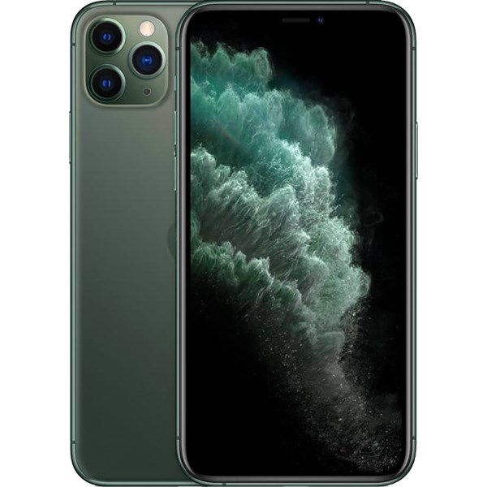
i O S 13 ( i Phone OS 13)
Apple announced iOS 13 on June 3, 2019, at its annual Apple Worldwide Developers Conference (WWDC) event, and it was released to the public on September 19, 2019 alongside the iPhone 11 series (11, 11 Pro, 11 Pro Max). The principal features include dark mode and Memoji support for A9+ devices. The NFC framework now supports reading several types of contactless smartcards and tags.^{[155]} The iPad gains several tablet-oriented features, and its operating system has been rebranded as iPadOS; iPadOS 13 was announced at the 2019 WWDC as well. With this release, Apple dropped support for all devices with less than 2 GB of RAM, which included the iPhone 5S and iPhone 6 and 6 Plus, iPod Touch (6th generation), iPad Mini 2, iPad Mini 3, and iPad Air. iOS 13/iPadOS 13 has limited support on devices with the A8/A8X or A9/A9X processors: the first-generation iPhone SE, iPhone 6S/6S Plus, iPad Mini 4, iPad Air 2, iPad (5th generation), and iPad Pro (1st generation). However, all other devices from the iPhone 7/7 Plus onwards, iPod Touch (7th generation), iPad Pro (2nd generation), iPad (6th generation), and iPad Mini (5th generation) onwards are fully supported. iOS 13 brought support for the iPhone 11 and iPhone 11 Pro / Pro Max, second-generation iPhone SE, and iPadOS 13 brought support for the iPad (7th generation), the iPad Pro (12.9-inch, 4th generation) and the iPad Pro (11-inch, 2nd generation).

Slide 19
i O S 14 ( i Phone OS 14)
Apple announced iOS 14 and iPadOS 14 on June 22, 2020 at its annual WWDC 2020 event, with a developer beta released on the same day and a public beta released on July 9, 2020.^{[162]} iOS 14 and iPadOS 14 were released on September 16, 2020. All devices that supported iOS 13 also support iOS 14. This makes the iPad Air 2 the first device to support seven versions of iOS and iPadOS, from iOS 8 to iPadOS 14. Some new features introduced in iOS 14 and iPadOS 14 include redesigned widgets that can now be placed directly on the homescreen, along with the App Library, which automatically categorizes apps into one page, Picture in Picture in iPhone and iPod touch, and the CarKey technology to unlock and start a car with NFC. iOS and iPadOS 14 also allow the user to have incoming calls shown in banners rather than taking up the whole screen (the latter view is still available as an optional function).^{[163]} iOS 14 and iPadOS 14 have limited support on devices with an A8, A8X, A9 or A9X chip: the iPhone 6S, the iPhone 6S Plus, the first generation iPhone SE, the iPad Air 2, the iPad Mini 4, the 5th generation iPad and the first generation iPad Pros. Devices from the iPhone 7/7 Plus onwards, the iPod Touch (7th generation), the iPad Pro (2nd generation), iPad (6th generation), iPad Air (3rd generation) and iPad Mini (5th generation) onwards are fully supported.

Slide 20
i O S 14 ( i Phone OS 14)
Apple announced iOS 14 and iPadOS 14 on June 22, 2020 at its annual WWDC 2020 event, with a developer beta released on the same day and a public beta released on July 9, 2020.^{[162]} iOS 14 and iPadOS 14 were released on September 16, 2020. All devices that supported iOS 13 also support iOS 14. This makes the iPad Air 2 the first device to support seven versions of iOS and iPadOS, from iOS 8 to iPadOS 14. Some new features introduced in iOS 14 and iPadOS 14 include redesigned widgets that can now be placed directly on the homescreen, along with the App Library, which automatically categorizes apps into one page, Picture in Picture in iPhone and iPod touch, and the CarKey technology to unlock and start a car with NFC. iOS and iPadOS 14 also allow the user to have incoming calls shown in banners rather than taking up the whole screen (the latter view is still available as an optional function).^{[163]} iOS 14 and iPadOS 14 have limited support on devices with an A8, A8X, A9 or A9X chip: the iPhone 6S, the iPhone 6S Plus, the first generation iPhone SE, the iPad Air 2, the iPad Mini 4, the 5th generation iPad and the first generation iPad Pros. Devices from the iPhone 7/7 Plus onwards, the iPod Touch (7th generation), the iPad Pro (2nd generation), iPad (6th generation), iPad Air (3rd generation) and iPad Mini (5th generation) onwards are fully supported.

Slide 21
iOS SDK
iOS is Apple’s mobile operating system.
Originally released for iPhone and iPod Touch, it has been
extended to support devices like iPad and Apple TV.
Derived from OSX, with which it shares the Darwin foundation and is therefore a UNIX-like operating system by nature.
Darwin is an open source POSIX compliant operating system released by Apple Inc. in 2000.
The user-interface of iOS is based on concept of direct manipulation, using multi-touch gestures.
Notes:
iOS là một phiên bản được tối ưu dành cho di động của hệ điều hành MacOS X được tạo ra bởi Apple. Nó cài đặt trên tất cả các thiết bị như iPod, iPhone hay iPad và chỉ chiếm khoảng 500 MB không gian lưu trữ. Tuy nhiên để có thể xây dựng các ứng dụng trên iOS thì không thể thiếu iOS SDK. Bộ SDK này chứa đầy đủ các thư viện để phát triển ứng dụng cũng như công cụ giả lập thiết bị giúp bạn có cái nhìn trực quan các ứng dụng chạy trên iPhone hay iPad.

Slide 22
iOS SDK
Unveiled with the iPhone at the MacWorld Conference & Expo, January 9, 2007 and released in June, 2007.
On March 6, 2008, Apple released the first beta of native Software Development Kit (SDK), along with a new name for the operating system : “iPhone OS”.
In June, 2010, Apple rebranded iPhone OS as “iOS”.
Notes:
iOS là một phiên bản được tối ưu dành cho di động của hệ điều hành MacOS X được tạo ra bởi Apple. Nó cài đặt trên tất cả các thiết bị như iPod, iPhone hay iPad và chỉ chiếm khoảng 500 MB không gian lưu trữ. Tuy nhiên để có thể xây dựng các ứng dụng trên iOS thì không thể thiếu iOS SDK. Bộ SDK này chứa đầy đủ các thư viện để phát triển ứng dụng cũng như công cụ giả lập thiết bị giúp bạn có cái nhìn trực quan các ứng dụng chạy trên iPhone hay iPad.

Slide 23
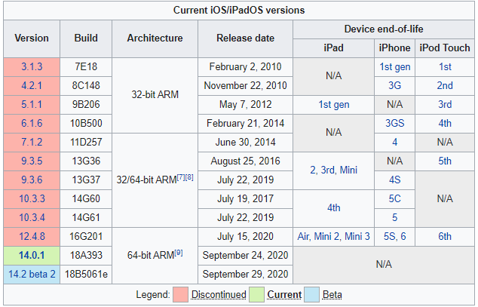
iOS SDK

Slide 24
iOS SDK
iPhone & iPod
Display: 3.5in, 4in
Resolution: 320x480(HVGA) at 163ppi, 640x960 at 326ppi, 1136x640
Aspect Ratio: 2:3, 16:9
Storage: 4GB, 8GB, 16GB, 32GB, 64GB
Processor: 620MHz, 833MHz, 1GHz Apple A4, 1GHz dual-core Apple A5, Apple A6, …
Bus Frequency and width: 103MHz (32-bit), 100MHz (32-bit), 100MHz (64-bit), 250MHz (64-bit)
Memory: 128MB, 256MB, 512MB, 1GB, 2GB, 4GB, 6GB
Devices: iPhone 3G, iPhone 3GS, iPhone 4, iPhone 4S, iPhone 5, iPod Touch

Slide 25
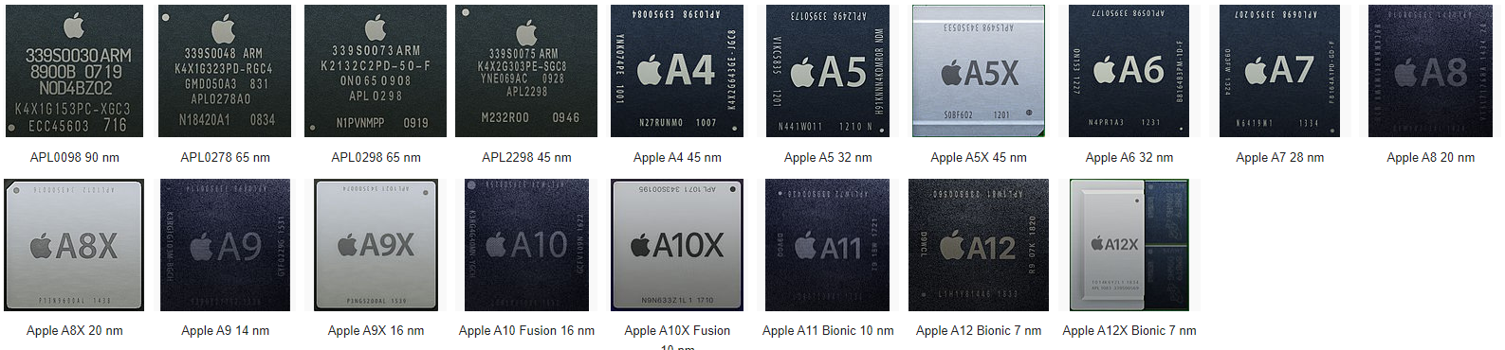
Hardware
Notes:
https://vi.wikipedia.org/wiki/Apple_SoC

Slide 26
Hardware
Proximity Sensor
deactivates the display and touchscreen when the device is brought near the face during a call.
3-axis Accelerometer
senses the orientation of the phone and changes the display accordingly.
Ambient Light Sensor
adjusts the display brightness which in turn saves battery power.
Gyroscopic Sensor
enhances the perception of how the phone is
moved.

Slide 27
Platform Characteristics
The Display is Paramount regardless of its size
Device Orientation can change
Apps Respond to Gestures, Not Clicks
People Interact with One App at a Time
Preferences are available in Settings
Onscreen User Help Is Minimal
Most iOS Apps Have a Single Window
Two Types of Software Run in iOS
iOS Apps
Web Content
Safari on iOS Provides the Web Interface

Slide 28
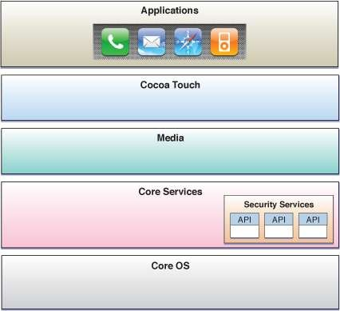
iOS Architecture

Slide 29
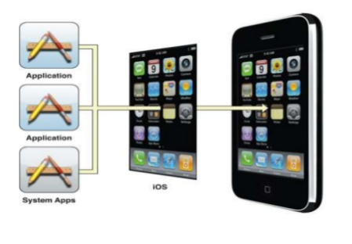
iOS Architecture
Working Process

Slide 30
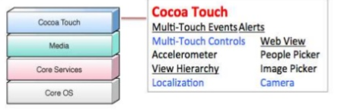
Cocoa Touch Layer
Auto Layout
Storyboards
Document Support
Multitasking
Printing
UI State Preservation
Apple Push Notification Service
Local Notifications
Gesture Recognizers
Peer-to-Peer Services
GameKit framework
Standard System View Controllers
UINavigatoinController, UITabBarController, UIPageView Controller etc.
External Display Support

Slide 31
Cocoa Touch Frameworks
AddressBookUI.framework
EventKitUI.framework: calendar- based events
GameKit.framework
iAd.framework
MapKit.framework
MessageUI.framework
Twitter.framework
UIKit.framework
Accelerometer data
The built-in camera (where present)
The user’s photo library
Device name and model information
Battery state information
Proximity sensor information

Slide 32
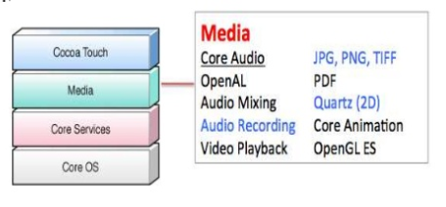
Media Layer
Graphics Technologies
Core Graphics (Quartz)
Core Animation
Core Image
OpenGL ES and GLKit
Core Text
Image I/O
Assets Library framework
Audio Technologies
Media Layer framework
AV Foundation framework
Open AL
Core Audio framework
Supported file formats: AAC Protected (MP4), ALAC, A-law, IMA/ADPCM (IMA4), Linear PCM, µ-law, DVI/Intel IMA ADPCM, Microsoft GSM 6.10, AES3-2003

Slide 33
Video Technologies
UIImagePickerController
Media Player framework
AV Foundation framework
Core Media
Supported file formats: .mov, .mp4, .m4v, .3gp
Compression Standards: H.264 video, up to 1.5Mbps, 640 by 480 pixels
H.264 video, up to 768Kbps, 320 by 240 pixels
MPEG-4 video, up to 2.5 Mbps, 640 by 480 pixels
AirPlay: AirPlay is a technology that lets your application stream audio to Apple
TV and to third-party AirPlay speakers and receivers. Support is built-in in:
AV Foundation framework
Core Audio

Slide 34
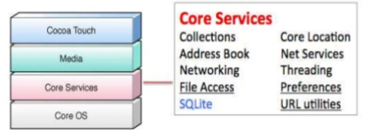
Core Services Layer
High Level Features
iCloud Storage
Automatic Reference Counting
Block Objects
Data Protection
File-Sharing Support
Grand Central Dispatch
In-App Purchase
SQLite
XML Support
Frameworks
Accounts Framework
Address Book Framework
Ad Support Framework
CFNetwork Framework
Core Data Framework
Core Foundation Framework
Core Location Framework
Core Media Framework
Core Motion Framework
Core Telephony Framework
Event Kit Framework
Foundation Framework
Newsstand Kit Framework
Pass Kit Framework
Quick Look Framework
Social Framework
Store Kit Framework
System Configuration Framework

Slide 35
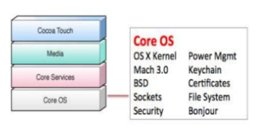
Core OS Layer
Frameworks
Accelerate Framework
Core Bluetooth Framework
External Accessory Framework
Generic Security Services Framework
Security Framework
System
LibSystem library
Threading (POSIX threads)
Networking (BSD sockets)
File-system access
Standard I/O
Bonjour and DNS services
Locale information
Memory allocation
Math computations

Slide 36
iOS SDK
Bước 1: Setup môi trường
Để phát triển các ứng dụng iPhone SDK và tiếp tục hướng dẫn này, bạn sẽ cần những điều sau đây:
Trang bị máy tính Intel có hệ điều hành Mac OS X
Để viết các native application với iOS SDK và thử nghiệm các ứng dụng của bạn trong iPhone chính thức của Apple hoặc Simulator iPad, bạn sẽ cần có hệ điều hành Snow Leopard hoặc version cao hơn cài trên máy tính để bàn hoặc máy tính xách tay của Apple. Tuy nhiên nếu bạn chỉ có máy tính chạy Windows thì cũng không phải quá lo lắng. Hãy đọc bài viết sau đây để có thể cài đặt môi trường lập trình iOS trên máy tính chạy Windows.
Tạo một tài khoản Apple cho developer
Điều này là cần thiết để tải Xcode IDE, iOS SDK và iPhone Simulator. Bạn sẽ cần phải đăng ký một tài khoản Apple cho Developer ở đây. Đăng ký là miễn phí và sẽ cho phép bạn chạy các ứng dụng trong mô phỏng iPhone. Một tài khoản miễn phí là tất cả những gì cần thiết cho hướng dẫn này, nhưng để thực sự chạy các ứng dụng của bạn trên một thiết bị hoặc công bố thông qua Apple Store, bạn sẽ cần phải trả tiền để đăng ký trong iPhone Developer Program.
Cài đặt Xcode và iOS SDK
Sau khi đăng nhập vào tài khoản Apple Developer, bạn có thể tải về và cài đặt Xcode ... và iPhone SDK … (hoặc phiên bản mới nhất – chú ý phải phù hợp với phiên bản MacOS X của bạn).

Slide 37
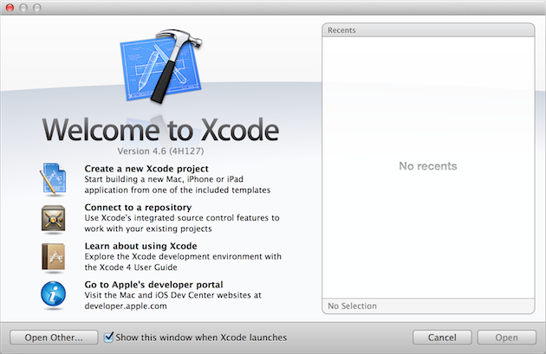
iOS SDK
Bước 2: Khởi động Xcode và tạo project mới
Xcode là một môi trường phát triển tích hợp (IDE) kết hợp nhiều công cụ cần thiết để xây dựng một chương trình vào một ứng dụng iPhone. Khởi chạy Xcode bây giờ bằng cách tìm kiếm nó trong spotlight hoặc sử dụng công cụ finder tìm đến đường dẫn cài đặt mặc định của /Developer/Applications/Xcode.
Chọn “Create a new Xcode project” từ hộp thoại xuất hiện.

Slide 38
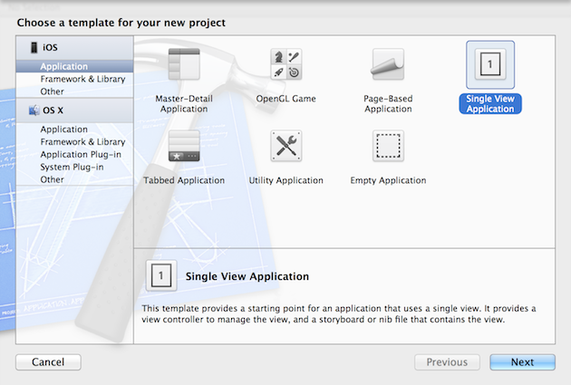
iOS SDK
Chọn Application dưới iOS ở cột bên trái. Trong danh mục Application bạn sẽ thấy rất nhiều loại application. Tuy nhiên trong bài viết này chúng tôi xin đề cử bạn chọn kiểu ứng dụng đơn giản nhất là “Single View Application” và sau đó nhấn Choose.

Slide 39
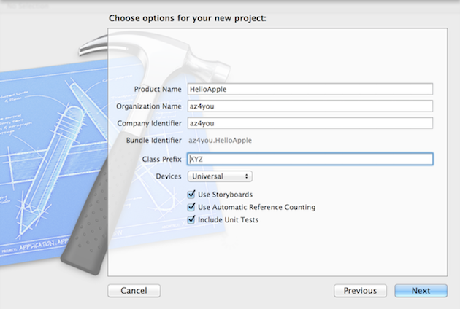
iOS SDK
Tiếp tục, chúng ta nhấn vào nút Next và sau đó khai báo các thông tin liên quan đến project.

Slide 40
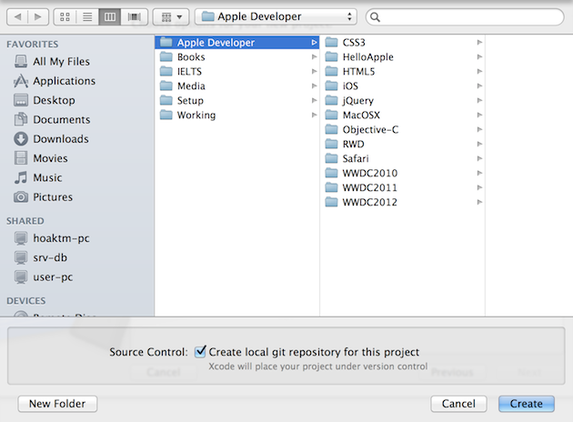
iOS SDK
Đặt tên project là HelloApple và tiếp tục chọn một thư mục trên ổ cứng của bạn để save project.

Slide 41
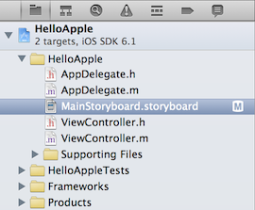
iOS SDK
Bước 3: Khởi động Interface Builder và tạo giao diện ứng dụng
Điều đầu tiên để bắt đầu cho việc tạo nên một giao diện cho ứng dụng iPhone là bạn phải hiểu cấu trúc của project. Bạn hạy nhìn vào project tree như hình bên dưới. Trong project tree có rất nhiều file và loại file sẽ khác nhau một chút theo từng phiên bản của Xcode. Cụ thể ở phiên bản Xcode 4.6 chúng tôi đang sử dụng thì để có thể sử dụng bộ công cụ Interface Builder để thiết kế giao diện cho ứng dụng trên iPhone thì xin mời bạn chọn và nhấn vào file “MainStorybroad.storyboard“.

Slide 42
iOS SDK
Interface Builder là một công cụ đồ họa cho phép bạn nhanh chóng và dễ dàng tạo ra layout cho các ứng dụng của bạn mà không cần viết một dòng mã Objective-C nào cả. Như chúng ta sẽ thấy, nó cũng cho phép bạn nhìn trực quan để xác định được mối quan hệ giữa các đối tượng như buttons và methods mà bạn viết trong ứng dụng của bạn. Cụ thể sau khi nhấn vào file storyboard thì giạo diện Interface Builder sẽ như sau:

Slide 43
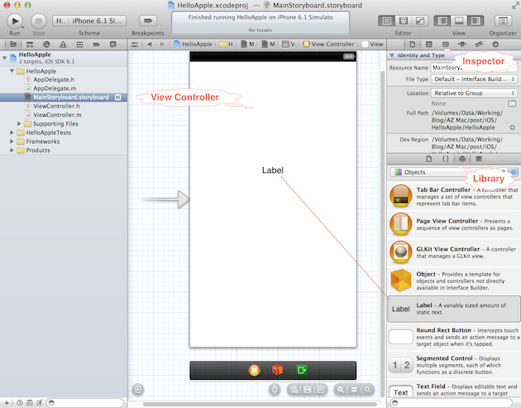
iOS SDK

Slide 44
iOS SDK
Công cụ Interface Builder gồm 3 phần chính mà bạn cần biết:
View Controller
View Controller cung cấp cho bạn cái nhìn trực quan ứng dụng của bạn trên một màn hình thiết bị cụ thể. Bạn có thể kéo thả các GUI control trong thanh Libray vào giao diện sau đó thiết lập các thuộc tính cũng như định dạng ở phần Inspector.
Library
Thư viện hiển thị các đối tượng như buttons, labels, và textfields có sẵn để sử dụng trong view của bạn. Các đối tượng có thể được tạo ra trong canvas của bạn chỉ đơn giản bằng cách kéo chúng vào các view instance. Để mở thư viện, chọn Tools> Libary từ thanh menu.
Inspector
Inspector cung cấp một cái nhìn chi tiết về các attributes và các connection giữa các đối tượng của bạn. Mở cửa sổ Inspector bằng cách chọn Tools> Inspector nếu nó chưa được mở. Lưu ý 4 thẻ tab ở phía trên cùng của cửa sổ Inspector: attributes, connections, size và identity.

Slide 45
iOS SDK
Bây giờ chúng ta sẽ làm quen với Interface Builder thông qua một ví dụ nhỏ. Ở trên phần Library, bạn chọn phần “Show Object Library“. Tiếp tục bạn sẽ nhìn thấy danh sách các GUI control thông dụng. Ở ví dụ này tôi chi muốn các bạn làm một thao tác đơn giả đó là tạo nên một giao diện với một label có dọng chữ “Hello Apple“. Để làm điều đó, ở bên phần “Object Library“, bạn kéo label control vào View Controller và thiết lập một số thuộc tính về font bên thanh Inspector> Show the Attrtibutes inspector. Kết quả sẽ như hình bên dưới:

Slide 46
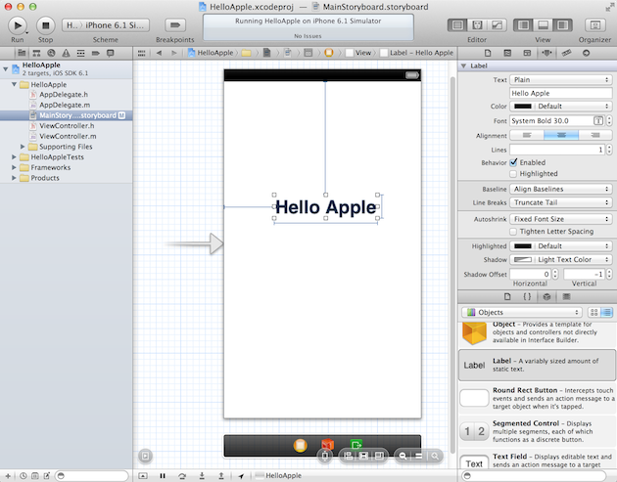
iOS SDK

Slide 47
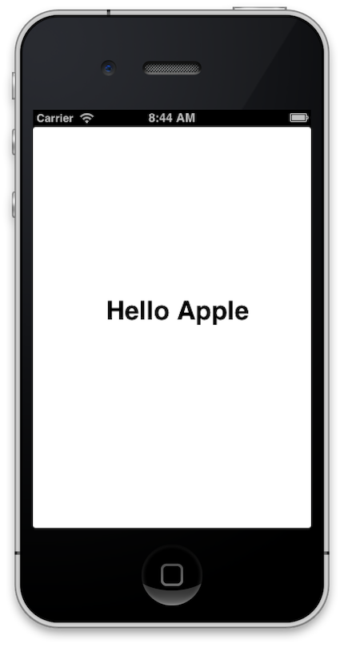
iOS SDK
Đến bước này chắc các bạn rất nóng lòng muốn chạy ngay đúng không? Đừng vội, hãy chắc chắn rằng bạn đã save tất cả công việc trong Interface Builder , sau đó chuyển về Xcode rồi nhấn nút Run để chạy ứng dụng của bạn lại một lần nữa. Bây giờ bạn một thông điệp “Hello Apple” trên màn hình.

Slide 48
Objective-C
Ojective-C là ngôn ngữ lập trình hướng đối tượng thường được dùng để viết các ứng dụng cho Mac OS X, iOS. Được thiết kế từ ngôn ngữ C bổ sung kiểu gọi hàm của ngôn ngữ Smalltalk. Được phát triển vào đầu những năm 80 bởi công ty NeXT (công ty của Steve Jobs khi ông rút lui khỏi Apple) Objective-C (obj-C) mở rộng từ ngôn ngữ C cho nên những thuộc tính, đặc điểm định nghĩa khái niệm của C nó đều có đủ.
Objective-C là ngôn ngữ lập trình như thế nào ? Hiểu một cách nôm na như mọi người vấn nói đó là ngôn ngữ C được thêm vào phần hướng đối tượng.

Slide 49
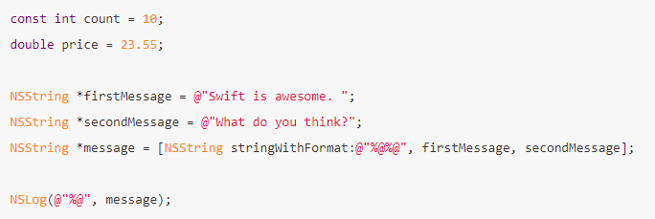
Objective-C
Biên dịch nhanh và mềm mại: Bản thân trình biên dịch C cũng là huyền thoại tốc độ rồi
Obj-C còn được trang bị thêm nhiều đặc điểm ngôn ngữ uyển chuyển (Dynamic Script Language) nữa. Ví dụ bạn có thể sử dụng kiểu tĩnh cho mọi biến nhưng những kiểu này lại không bị xử ký quá cứng nhắc…
Tương thích với C và C++: Bạn có thể sử dụng, khai báo tất cả các kiểu dữ liệu của C, C++. Trong thực tế có rất nhiều thư viện framework của Obj-C được viết bằng C, C++.
Tích hợp Cocoa: Cocoa được thiết kế cho Obj-C, đây là thư viện mạnh mẽ cho các ứng dụng cảm ứng..

Slide 50
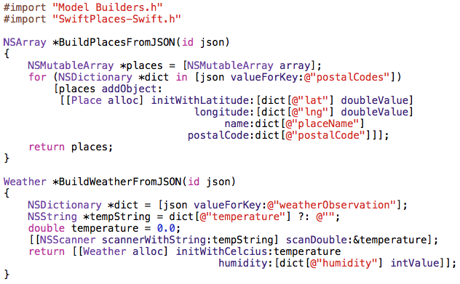
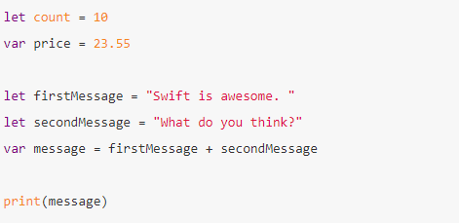
Swift
Sau 30 năm thống trị của Objective-C trên các nền tảng thuộc Apple, một thứ ngôn ngữ… cồng kềnh và khó dùng không kém gì C++, Swift đã xuất hiện như một cứu cánh cho tất cả những coder muốn dev iOS hay macOS.

Slide 51
Swift
Sau 30 năm thống trị của Objective-C trên các nền tảng thuộc Apple, một thứ ngôn ngữ… cồng kềnh và khó dùng không kém gì C++, Swift đã xuất hiện như một cứu cánh cho tất cả những coder muốn dev iOS hay macOS.
Swift ra đời năm 2014, tính đến nay là 6 năm tuổi, nhưng đã có tới phiên bản thứ 5.., cùng với việc open-source và xuất hiện trên Linux, chắc chắn Swift sẽ còn phát triển nhanh hơn nữa Tại sao Swift lại hot như vậy? Có thể kể đến các lý do sau:
Là ngôn ngữ biên dịch, compiler optimize tốt => Nhanh (Swift chạy trên server nhanh hơn hẳn NodeJS)
Syntax là tổng hợp tinh hoa của các ngôn ngữ lập trình hiện đại => Dễ viết, viết đẹp
Bắt buộc người code phải sử dụng thói quen tốt (good practice), có garbage collection, compiler…=> An toàn, ít lỗi
Tương thích tốt với Objective-C cũng như Cocoa Framework
Open-source, liên tục được update, không còn chỉ giới hạn trong nền tảng của Apple
Notes:
https://github.com/apple/swift

Slide 52
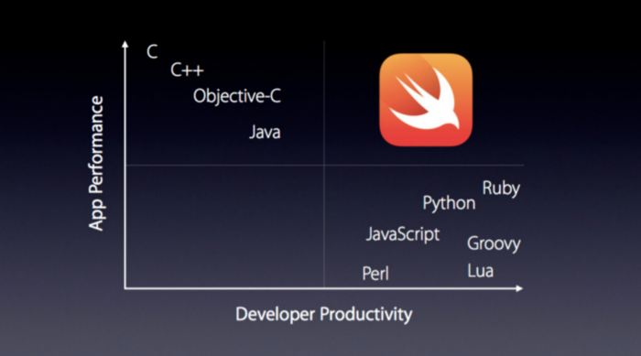
Swift

Slide 53
Swift
Vì là phát triển từ Objective-C, vốn là phát triển từ C nên cú pháp khá giống với các ngôn ngữ họ C (C++, C#, Java,…). Có điều…
Cuối câu lệnh không có chấm phẩy
Bạn không phải include hay khai báo class gì cả, Hello World chỉ đơn giản là Hello World
Khai báo biến có 2 từ khóa var và let. var là biến số, còn let là hằng số. Nếu giá trị khởi tạo đủ rõ ràng thì không cần khai báo kiểu
Swift cũng hỗ trợ Array (mặc định là mảng động), Dictionary (map trong C++) và Set
In ra xâu ez hơn bao giờ hết, tạm biệt %, tạm biệt +
If, for, while bắt buộc phải mở block (ngoặc nhọn í). Biểu thức của if, while bắt buộc trả về giá trị kiểu Boolean
Case trong switch tự động thoát sau khi kết thúc, không phải viết thêm một dòng break cuối mỗi case nữa
Switch không chỉ hỗ trợ so sánh bằng, bạn có thể sử dụng let-where để tạo điều kiện cho case

Slide 54

Swift
Vậy là đã xong phần syntax. Cùng ngồi nghỉ một lúc và ngắm “Swift” nào
Notes:
https://medium.com/vteam/l%C3%A0m-quen-v%E1%BB%9Bi-swift-trong-15-ph%C3%BAt-a7e9ce1d0f1

Slide 55
Swift
Example
Hello World
// This program displays "Hello world!" // // References: // https:
//developer.apple.com/library/content/documentation/Swift/Conceptual/Swift_Programming_Language/Gui
dedTour.html
print("Hello world!")

Slide 56
Swift
// Declare our new class
class Person {
// We can define class property here
var age = 25
// Implement Class initializer. Initializers are called when a new object of this class is created
init() {
print(“A new instance of this class Person is created.”)
}
}
// We can now create an instance of class Person - an object - by putting parentheses after the class name let personObj = Person()
// Once an instance of Person class is created we can access its properties using the dot “.” syntax. print(“This person age is \(personObj.age)”)
Notes:
http://swiftdeveloperblog.com/code-examples/

Slide 57


QUESTIONS?

